Slide 1
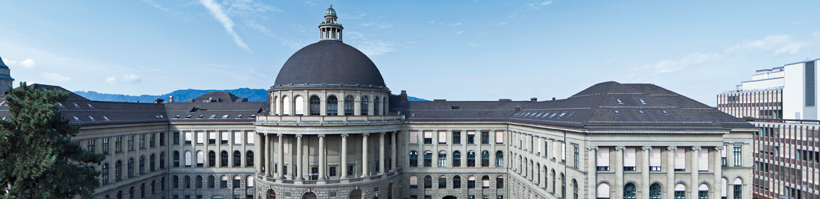
Modelling the evolution of human trail systems Dirk Helbing, Joachim Keltsch & Péter Molnár
Is the model capable of reproducing trail systems that emerged in the real world?
Team FreeWalk: Robin Stähli, Christoph Martin, Lukas Bircher
Robin Stähli, Christoph Martin and Lukas Bircher
18.12.2018
1
Notes:
Robin
Idee park, wissenschaftliche Frage
1

Slide 2
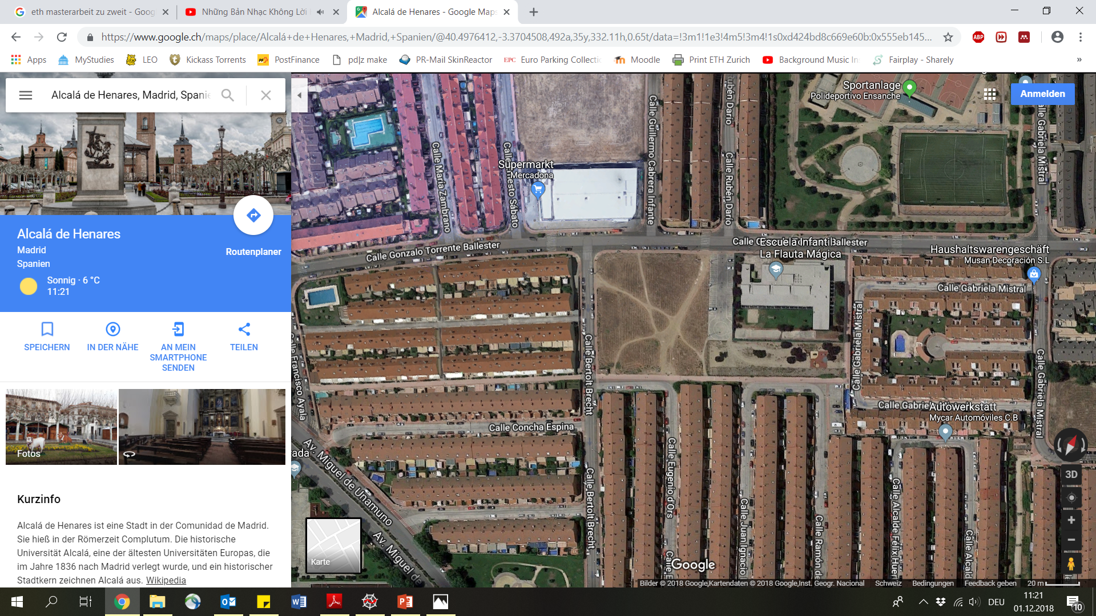
Trails in urban “green” spaces such as parks
University Campus Stuttgart Germany
Park in Alcalá (Madrid, Spain)
Robin Stähli, Christoph Martin and Lukas Bircher
18.12.2018
2
Notes:
Verknüpfung realität
Paper erklärt menschen gemachte trails
Ersten schritt reproduced model form paper
Zweiter Schritt realistische park umgebung implementiert und parameter von model probiert rekonstruieren. Realitätsnahe parameter finden.
2

Slide 3


Trail development
$\frac{dG\left(r,T\right)}{dt}=\frac{1}{T}\left[G_{0}\left(r\right)−G\left(r,t\right)\right]+I\left[1−\frac{G\left(r,t\right)}{G_{max}\left(r\right)}\right]\sum_{α}{δ(r−r_{α\left(t\right)})}$
Ground modification
Ground regeneration
Ground destruction from pedestrian
$$+ \frac{dG\left(r,T\right)}{dt}$$
Notes:
An empty field consists of the dark pixels only. To generate paths, we need to modify the field.
The ground gan either be regenerated (when the grass regrows) or destructed, when a pedestrian steps on the grass.
This is done iteratively. After the pedestrian arrives at the new pixel, the whole field is regenerated and the new pixel is «destroyed».

Slide 4

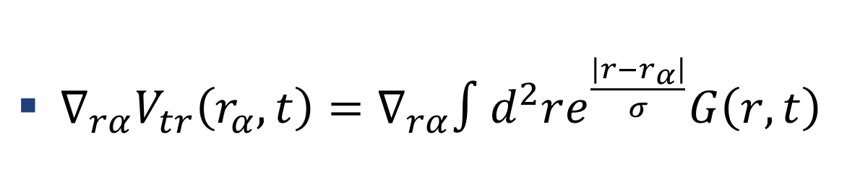
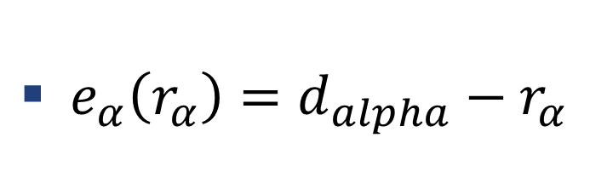
Trail / destination attraction
${∇_{rα}V}_{tr}\left(r_{α},t\right)=∇_{rα}∫d^{2}re^{\frac{\left|r−r_{α}\right|}{σ}}G\left(r,t\right)$
$e_{α}\left(r_{α}\right)=d_{alpha}−r_{α}$
Attraction of trails
Attraction of destination
Robin Stähli, Christoph Martin and Lukas Bircher
18.12.2018
4
Notes:
The pedestrian choses his walking direction from two inputs: The attraction of trails (you can see one trail in the bottom picture in yellow) and the attraction of the destination he wants to reach.
4

Slide 5

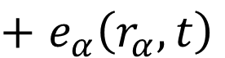
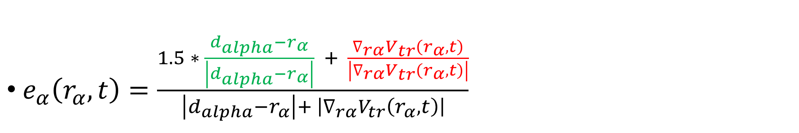
Walking direction
$e_{α}\left(r_{α},t\right)=\frac{1.5 ∗ \frac{d_{alpha}−r_{α}}{\left|d_{alpha}−r_{α}\right|} + \frac{∇_{rα}V_{tr}\left(r_{α},t\right)}{\left|∇_{rα}V_{tr}\left(r_{α},t\right)\right|}}{\left|d_{alpha}−r_{α}\right|+ \left|∇_{rα}V_{tr}\left(r_{α},t\right)\right|}$
Walking direction
$+$ $e_{α}\left(r_{α},t\right)$
Robin Stähli, Christoph Martin and Lukas Bircher
18.12.2018
5
Notes:
The resulting direction is calculated from the normalized attractions. The formula is complemented with a factor 1.5 on the attraction of trails.
Then the position of the pedestrian is updated.
5

Slide 6
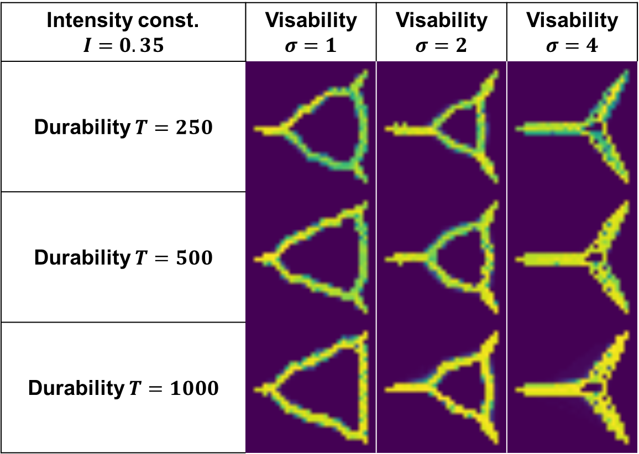
Direct- vs. Minimal way systems
Intensity const. $$I=0.35$$ | Visability $σ=1$ | Visability $σ=2$ | Visability $σ=4$
Durability $T=250$
Durability $T=500$
Durability $T=1000$
Robin Stähli, Christoph Martin and Lukas Bircher
18.12.2018
6
Notes:
Erklären Minimal and direct Way System abhängig von sigma.
6

Slide 7
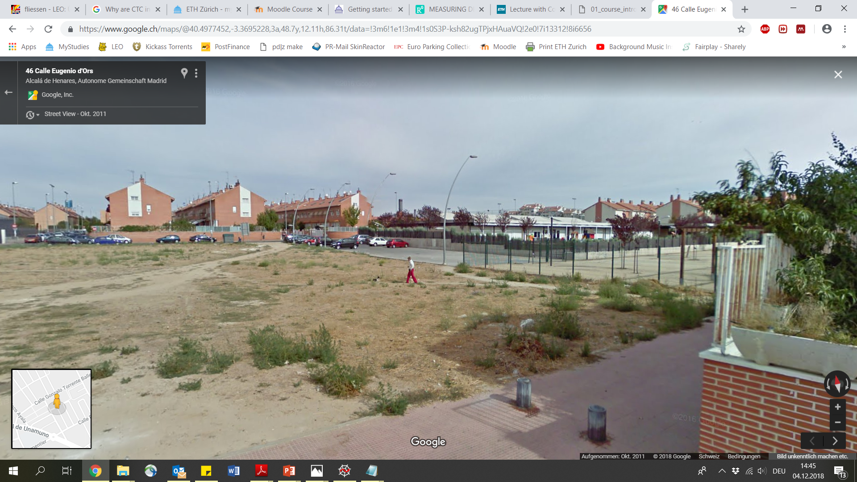
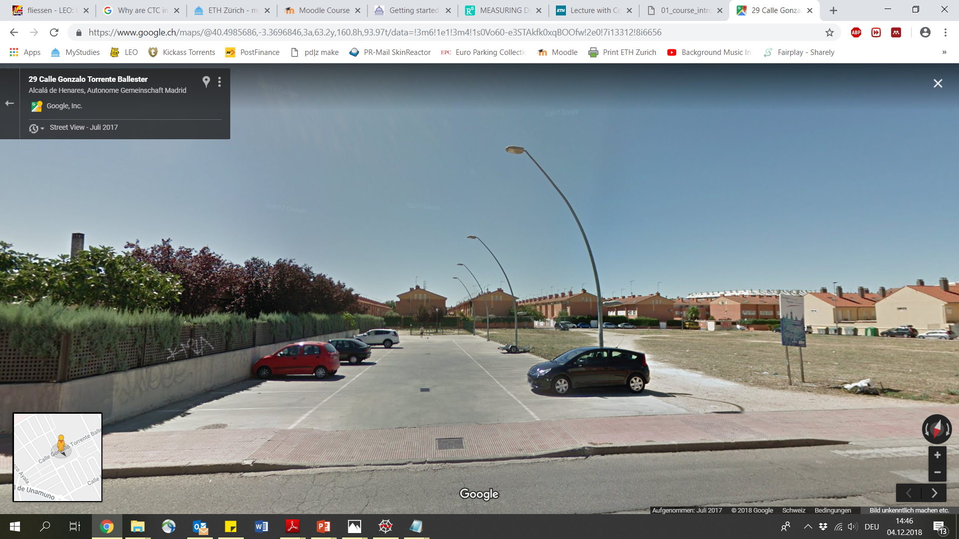
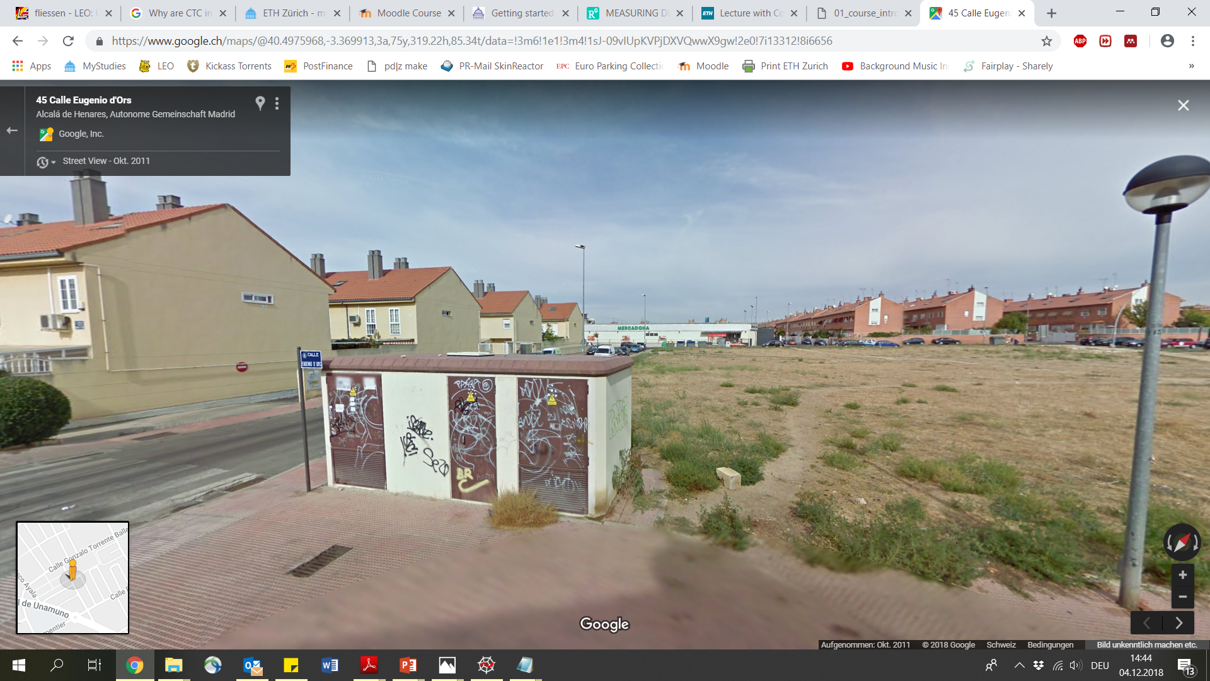

Environmental boundary condition
Pavement around park
Parking space
Fence
House
Robin Stähli, Christoph Martin and Lukas Bircher
18.12.2018
7
Notes:
Lukas
7

Slide 8
Pedestrian distribution
Residential zone, accesses to super market
Accesses to super market, small residential zone, pre school
6
1
5
Residential zone
Big sport area, way to bus station
2
4
Residential zone, way to train station
3
Residential zone
Robin Stähli, Christoph Martin and Lukas Bircher
18.12.2018
8
Notes:
More depanding on sigma than on other factors
As can be read in the paper the model evaluates direct or minimal way systems depending on the parameter. Model works like in paper shown.
8

Slide 9

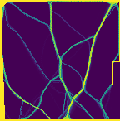
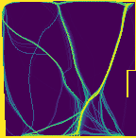


Trail evolution starting from empty field
Existing trails
Starting field
σ = 3
σ = 6
σ = 12
Robin Stähli, Christoph Martin and Lukas Bircher
18.12.2018
9
Notes:
Park entspricht eher einem direct way system
3er schön rechter ecken
6er eher linke obere seite realitäts näher ausgebildet
12er total andere charakteristik
Wert von 3 entspricht am ehstem Park
9

Slide 10




Trail evolution starting form actual trail systems
Starting field
σ = 3
σ = 6
σ = 12
Robin Stähli, Christoph Martin and Lukas Bircher
18.12.2018
10
Notes:
Erkenntnisse Directway system überprüfen mit ausgebildeter park….
Starting field schon ausgebildete wege, nur leute ersichtlich wenn leute neben weg laufen…
Weil park eher einem direct way system entspricht folgen sind mit parameter für ein minimal way-system grosse abweichungen erkennbar
More depanding on sigma than on other factors
As can be read in the paper the model evaluates direct or minimal way systems depending on the parameter. Model works like in paper shown.
The results imply that the model represents reasonably the reality
10

Slide 11
Discussion
Pavement around park
Pavement around park
Parking space
Parking space
Fence
Fence
House
House
Robin Stähli, Christoph Martin and Lukas Bircher
18.12.2018
11
Notes:
Robin
Übergangssatz Lukas: The results imply that the model represents reasonably the reality
Realitätsvergleich Boundary condition okay
11

Slide 12
Conclusion
The code seems to be applicable to reality
Model parameter are difficult to identify
Better estimation methods for pedestrian distribution could be applied
Robin Stähli, Christoph Martin and Lukas Bircher
18.12.2018
12
Notes:
Robin
More depanding on sigma than on other factors
As can be read in the paper the model evaluates direct or minimal way systems depending on the parameter. Model works like in paper shown.
12

Slide 13

Visualisation of trail evolution
Robin Stähli, Christoph Martin and Lukas Bircher
18.12.2018
13
Notes:
13

Slide 14
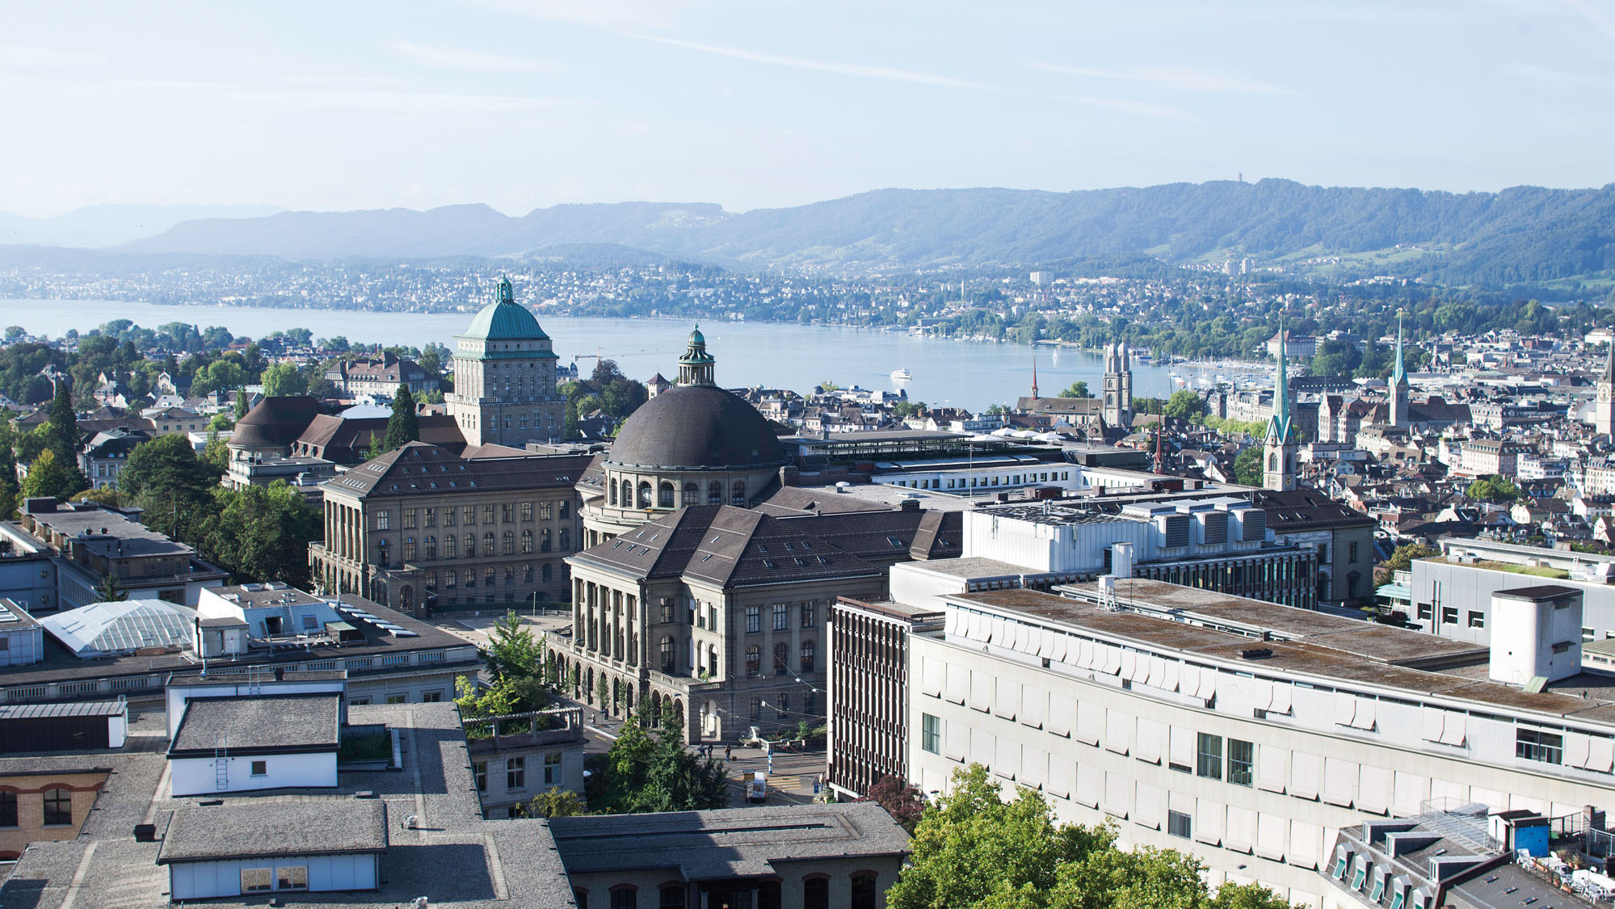
Questions?
?
Notes:
14

Slide 15
Sources
Dirk Helbing, Joachim Keltsch & Péter Molnár. Modeling the evolution of human trail systems. Macmillan PublishersLtd, Nature, 1997
Robin Stähli, Christoph Martin and Lukas Bircher
18.12.2018
15
Notes:
More depanding on sigma than on other factors
As can be read in the paper the model evaluates direct or minimal way systems depending on the parameter. Model works like in paper shown.
15

Slide 16

Implementation of Model
old field
new position
new field
new = old
old position

Slide 17
Outlook
Differences of height in the ground
Fixed, unpassable obstacles
Robin Stähli, Christoph Martin and Lukas Bircher
18.12.2018
17
Notes:
More depanding on sigma than on other factors
As can be read in the paper the model evaluates direct or minimal way systems depending on the parameter. Model works like in paper shown.
17

Slide 18
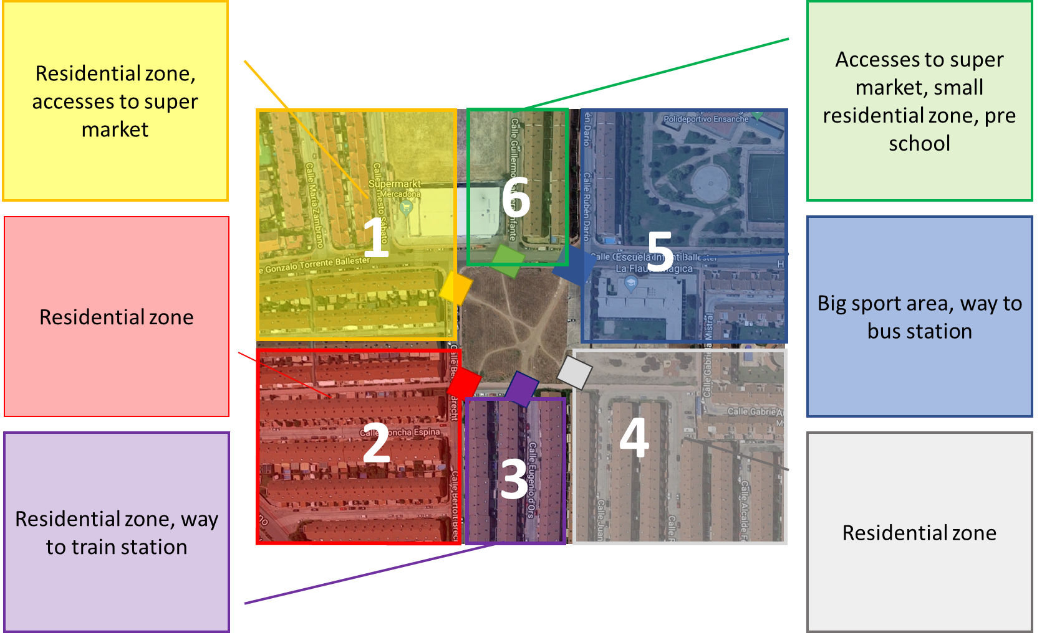
Pedestrian distribution
2 Spawn-Point
2 Spawn-Point
2 Spawn-Point
8 Spawn-Point
8 Spawn-Point
2 Spawn-Point
Robin Stähli, Christoph Martin and Lukas Bircher
18.12.2018
18
Notes:
More depanding on sigma than on other factors
As can be read in the paper the model evaluates direct or minimal way systems depending on the parameter. Model works like in paper shown.
18

